Slide 1
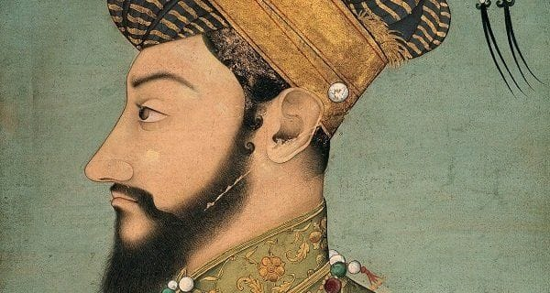
Ziauddin Barani
Introduction
Ziauddin Barani (1285–1357 CE) was a historian and political thinker of the Delhi Sultanate.
Served in the court of Muhammad bin Tughlaq and Firuz Shah Tughlaq.
Known for his Persian historical writings, especially his analysis of state, society, and caste.

Slide 2
Major Works:
1)Tarikh-i-Firuz Shahi
A historical chronicle covering the period from Balban (1266 CE) to Firuz Shah Tughlaq (1351 CE).
Focuses on the political and administrative history of the Delhi Sultanate.
Criticizes the policies of Muhammad bin Tughlaq.
2) Fatwa-i-Jahandari
A political treatise emphasizing Islamic governance and social hierarchy.
Advocates for a strict division between the ruling class and common people.
Promotes discrimination against non-Muslims in administration.
Hasht-Bihisht (Eight Paradises) – A lesser-known work on history.

Slide 3
Historiographical Contributions
Introduced a more analytical approach to history by emphasizing cause-and-effect relationships in political developments.
His works provide insights into courtly culture, social hierarchies, and the role of religion in politics.

Slide 4
AL BIRUNI:
Introduction
Full Name: Abu Rayhan Muhammad ibn Ahmad Al-Biruni
Born: 973 CE in Kath, Khwarezm (modern Uzbekistan)
Died: 1048 CE in Ghazni (modern Afghanistan)
Fields of Work: History, Geography, Mathematics, Astronomy, Physics, Medicine, and Linguistics.
Studied various subjects, including philosophy, astronomy, and languages (Persian, Arabic, Sanskrit, Greek, and Syriac).
Lived under the patronage of different rulers, including the Ghaznavid Sultan Mahmud of Ghazni.

Slide 5
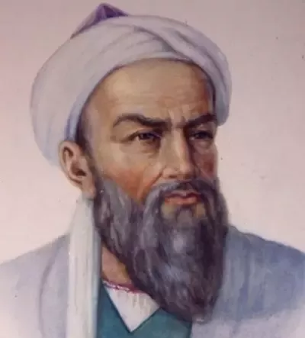
Contributions to Science and Other Fields 1. Astronomy and Mathematics Accurately calculated the Earth’s circumference. Developed trigonometric methods for astronomical calculations. 2. Geography and Cartography Proposed the idea that the Indian Ocean and Atlantic Ocean were connected. Mapped various regions and studied their climates. 3. Medicine and Physics Studied human anatomy, diseases, and medicinal plants. Discussed gravity and the concept of acceleration.

Slide 6
Major Contributions to History 1. Kitab Tarikh al-Hind (History of India) A comprehensive study of Indian culture, history, and religion. Based on his travels in India and interactions with scholars. Provided detailed observations on Hinduism, caste system, social customs, and sciences. Compared Indian knowledge with Greek and Islamic traditions. 2. Chronology of Ancient Nations A historical and chronological account of different civilizations, including Persians, Greeks, Romans, and Indians. Attempted to synchronize historical events across different cultures. 3. Contributions to Historiography Used a scientific and objective approach in historical writing. Relied on first-hand observations and cross-cultural comparisons. Avoided bias by verifying sources before documenting history.

Slide 7
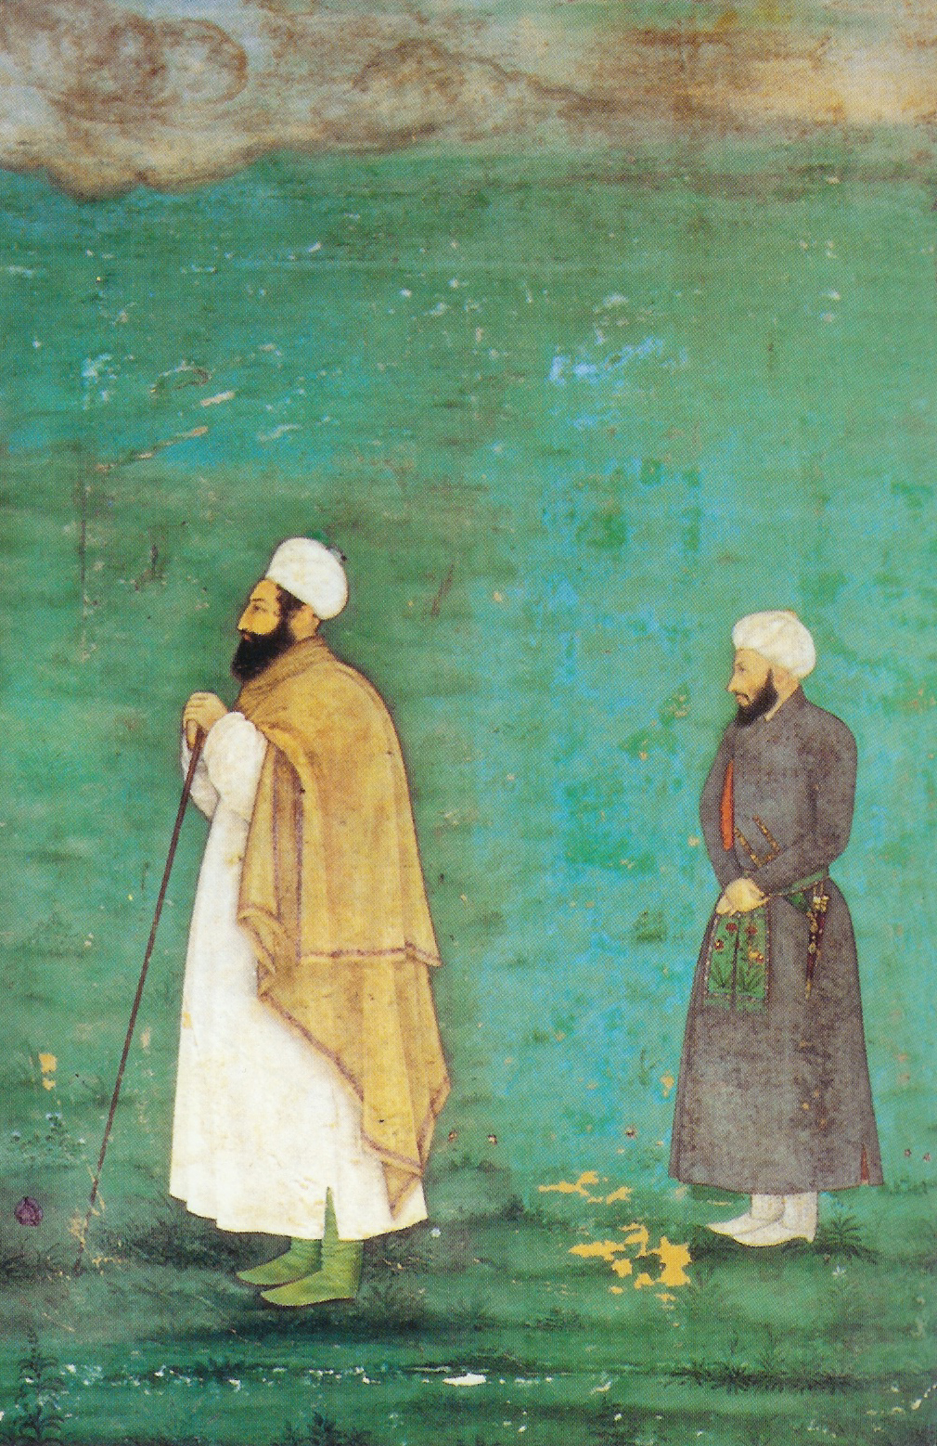
YAHYA IBN AHMAD SIRHINDI
Full Name: Yahya ibn Ahmad al-Sirhindi
Era: Late 14th to early 15th century (Timurid period)
Region: Sirhind (modern-day Punjab, India)
Background: A prominent historian and scholar during the Timurid era in India.
Birth and Early Life: Born in Sirhind, a historically significant city in Punjab, India.
Timurid Connection: Lived during the reign of Timur (Tamerlane) and his successors, a period marked by political upheaval and cultural flourishing.
Role: Served as a historian and chronicler, documenting the events of his time.

Slide 8
Major Work: Tarikh-i Mubarak Shahi Title: Tarikh-i Mubarak Shahi (The History of Mubarak Shah) Dedication: Named after Mubarak Shah, the second ruler of the Sayyid dynasty of Delhi. Content: Covers the history of India from the early Muslim conquests (12th century) to the reign of Mubarak Shah (early 15th century). Provides detailed accounts of the Delhi Sultanate, including the Ghaznavid, Ghurid, and Timurid periods. Focuses on political events, dynastic changes, and the socio-cultural landscape of medieval India. Significance: One of the most important primary sources for the history of the Delhi Sultanate. Offers insights into the administration, military campaigns, and cultural developments of the time.

Slide 9
Contributions to History Historical Documentation: Preserved valuable information about the Delhi Sultanate and its rulers. Highlighted the interactions between Central Asian and Indian cultures during the Timurid period. Cultural Insights: Provided a detailed account of the socio-religious conditions of medieval India. Documented the impact of Islamic rule on Indian society.

Slide 10
THANKS

